Slide 1
Transport Techniques Networks
TCP Chat Application
Supervisor:
D.JEHAD HAMAMREH
STUDENT:
AMR SHARIF(12326952)

Slide 2
TCP Chat Application
A simple client-server chat system using TCP sockets

Slide 3
Project Idea
Communication between server and multiple clients
Using TCP protocol
Real-time message exchange

Slide 4
What is TCP?
Reliable protocol
Connection-oriented
Ensures data delivery
Used in chat applications

Slide 5
System Components
Server: Handles connections
Client: Sends/receives messages
Socket: Communication endpoint

Slide 6
How It Works
Server listens on port
Client connects
Messages exchanged
Connection maintained

Slide 7
Server Responsibilities
Bind IP and Port
Listen for clients
Accept connections
Send/receive messages

Slide 8
Client Responsibilities
Connect to server
Send messages
Receive messages
Display output

Slide 9
Features
Real-time chat
Multiple clients (optional)
Simple interface
Easy to implement

Slide 10
Challenges
Handling multiple clients
Avoid blocking
Managing errors
Port conflicts

Slide 11
Conclusion
TCP chat apps demonstrate networking basics
Useful for understanding sockets
Foundation for advanced systems

Slide 12
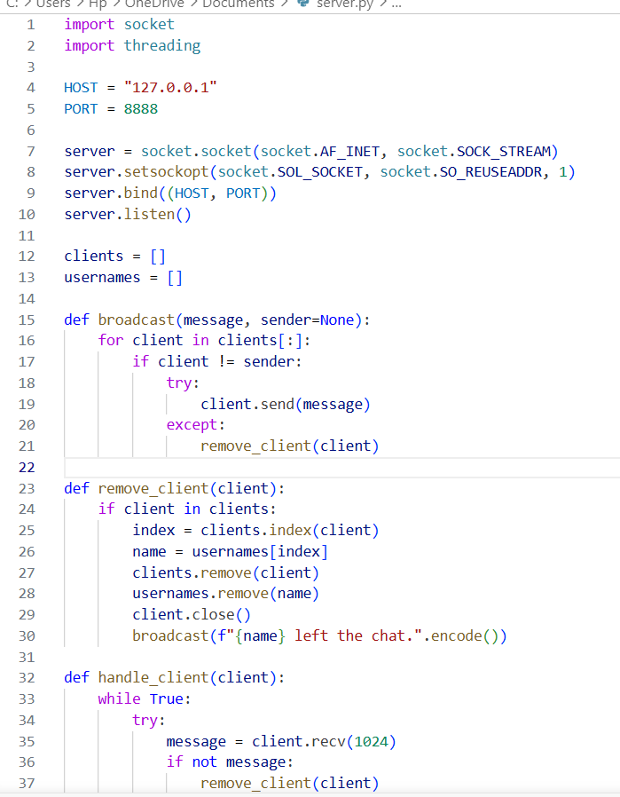
SERVER PYTHON.CODE:

Slide 13
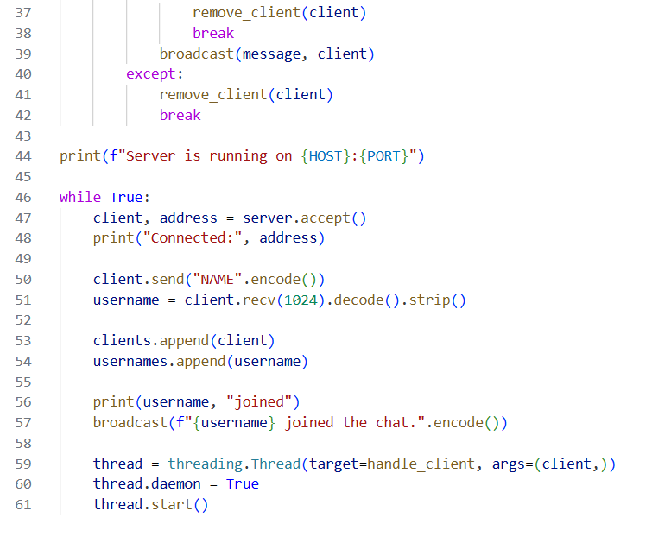

Slide 14
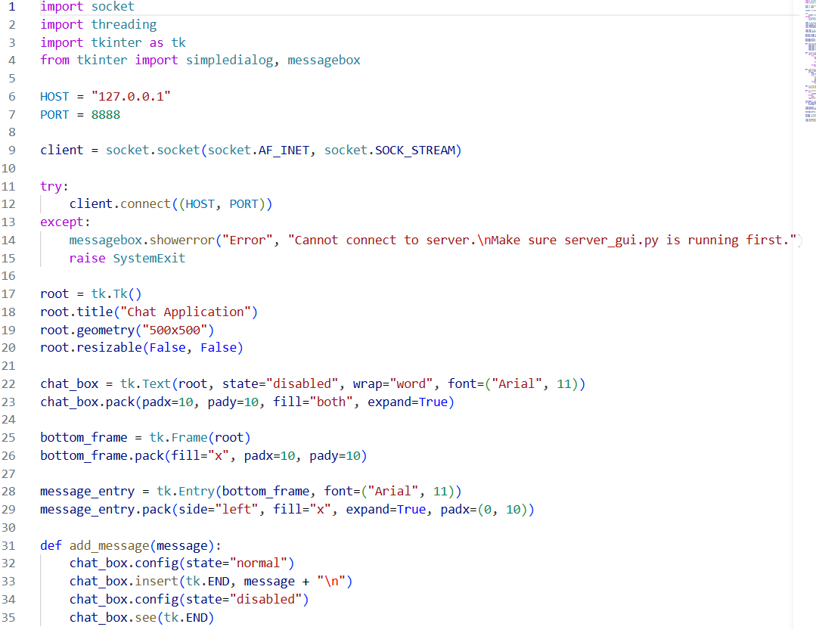
CLIENT PYTHON.CODE:

Slide 15
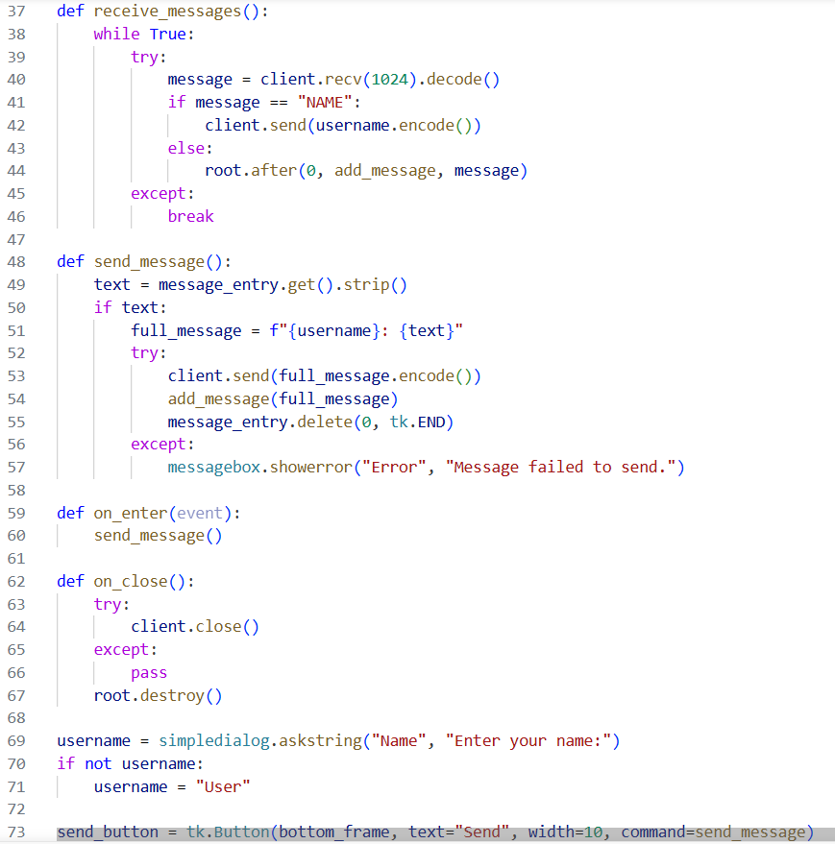

Slide 16
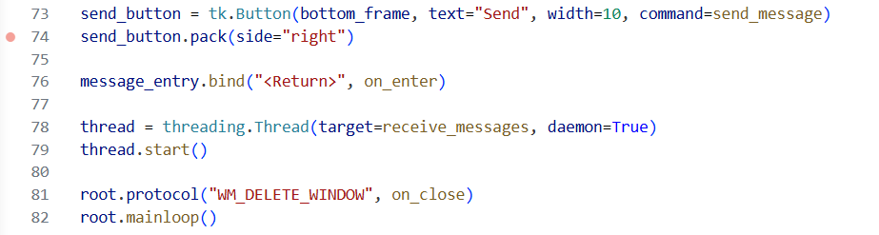

Slide 17
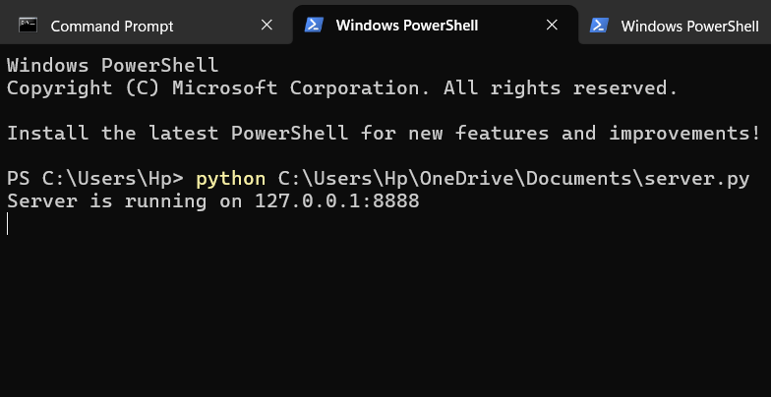
DEMO FOR PROJECT SERVER:

Slide 18
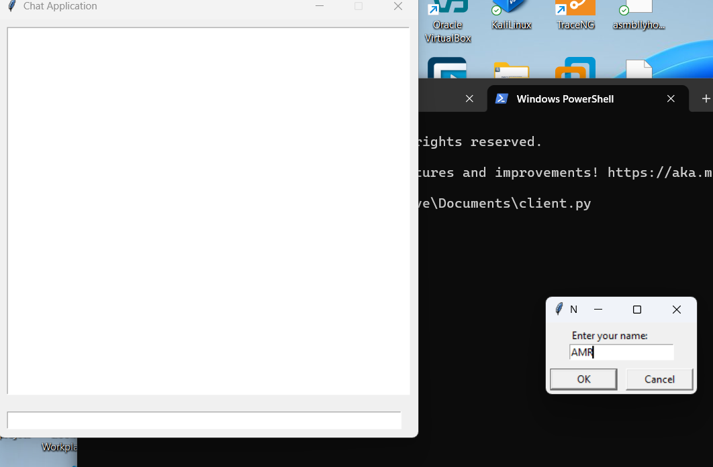
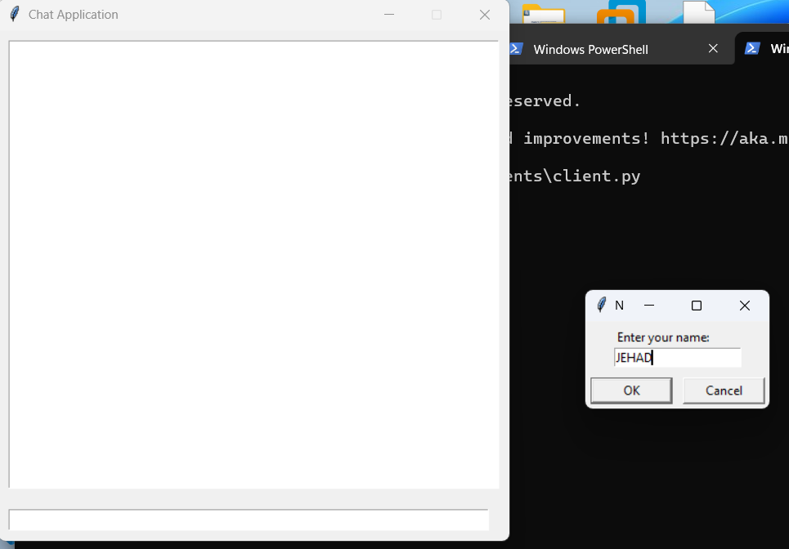
DEMO FOR CLIENTS:

Slide 19
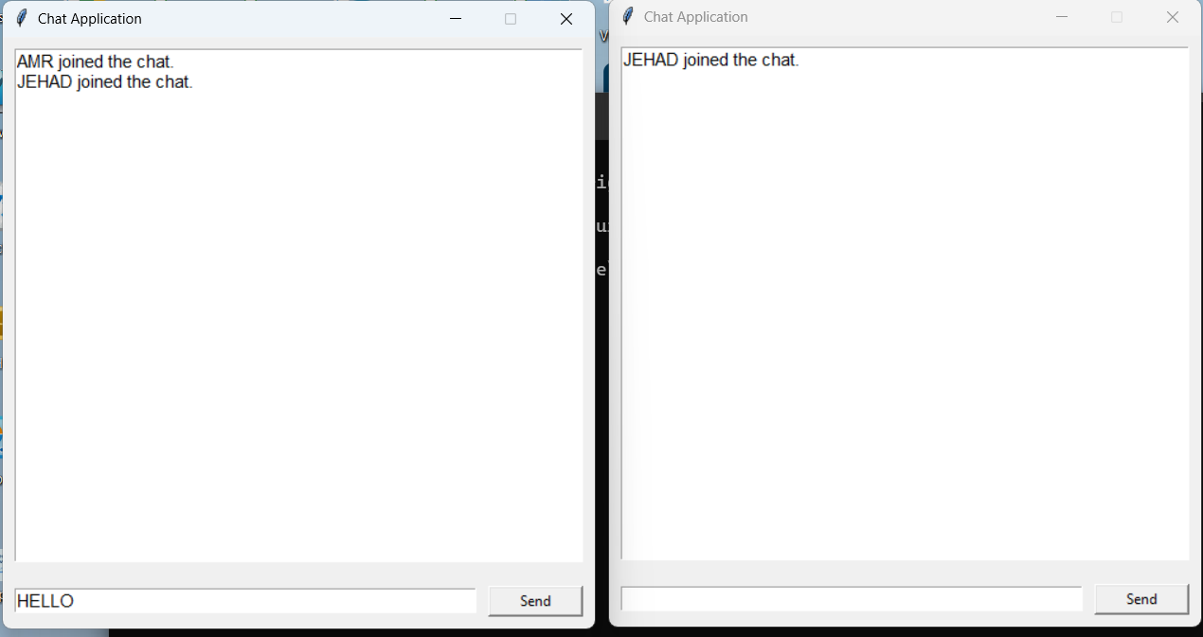

Slide 20
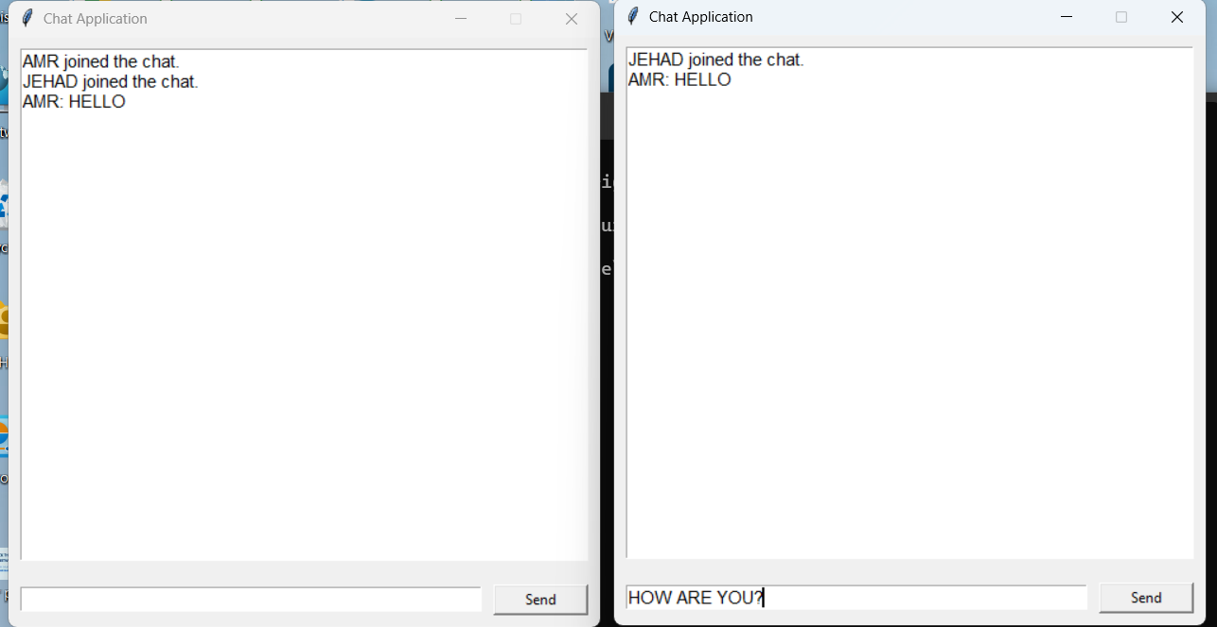

Slide 21
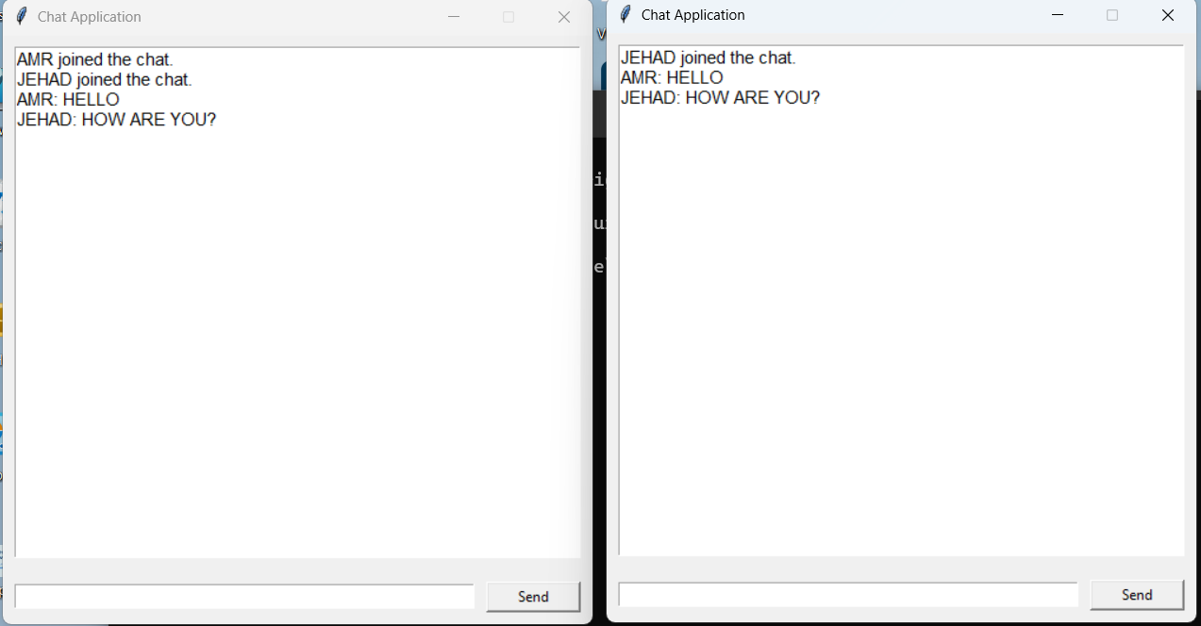

Slide 22
THANK YOU

